Slide 1
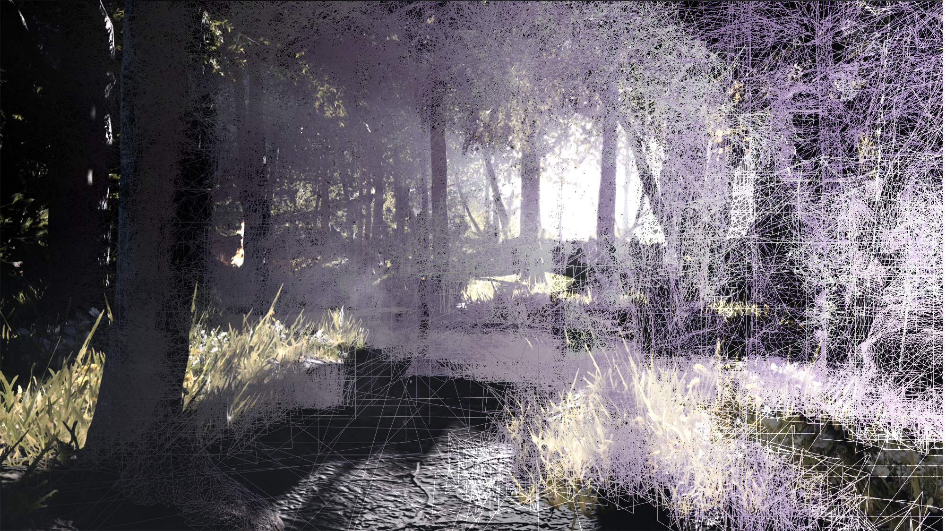

Geometry Rendering Pipeline architecture
Michal Drobot
© 2021 Activision Publishing, Inc.
Notes:
Hey!
My name is Michal Drobot and I am a Technology Fellow at Infinity Ward Activision.
This talk presents our Geometry Rendering Pipeline Architecture.

Slide 2
Acknowledgements
Primary contributors to GPU Pipeline
  Felipe Gomez-Frittelli, Keng Hua Sing, Michal Szymczyk
Central Technology
  Michael Vance
Special thanks to course organizers
© 2021 Activision Publishing, Inc.
© 2020 Activision Publishing, Inc.
Notes:
Before I start, I want to point out the amazing engineers I had privilege to work and brainstorm with during GPU Pipeline architecture and creation.
Keng Hua Sing is the primary engineer on UGB effort as well as main contributor to GPU pipeline as a whole.
Felipe Gomez-Frittelli was always there to brainstorm and help. He is also the primary engineer on bindless and mass draw effort.
Michal Szymczyk was our brainstorm partner and helped with CPU side of things.
I would also like to extend my thanks to our amazing course organizers.
Now without further ado let us move to the presentation.

Slide 3
Scene Triangle Limits
  Linear FPS : ~ 750 000
  Open World FPS : > 8 000 000
© 2021 Activision Publishing, Inc.
© 2021 Activision Publishing, Inc.
Notes:
Our titles are becoming increasingly complex when it comes to rendering scenarios.
Moving from tight enclosed spaces to open worlds literally opened the floodgates for all new rendering challenges.
And to top it off we threw in foliage, lots of it, into the mix – which has always been problematic to render at high framerates.
Historically we had very tight budgets of about 750k triangles submitted to GPU per-frame.
Moving to open world scenarios our scenes are suddenly hitting 8mln triangles. That’s a 10-fold difference, same engine, same target platform.
Initially we thought our LOD systems would be able to handle this change, especially as we invested heavily into hierarchical LODs as well as baking out parts of map as proxy LODs [RAY2020] While those systems did well, we still couldn’t avoid rising triangle count due to depth complexity and occlusion issues that come from long distance rendering of natural environments. In complex scenes, where occlusion is only partial due sparse occlude fusion from forests and tons of small assets building cityscapes, fine grained occlusion becomes paramount.
This drastic change required us to totally rethink our geometry submission and processing architecture.

Slide 4
Problems
  Many objects
  Inefficient rendering of dense meshes
Notes:
To sum up our problem space:
We want to render significant amount of geometry.
Meshes are getting progressively denser and we are getting close to triangle shading efficiency limits – often hitting triangle per pixel quad level of geometric complexity.

Slide 5
Problems
  Inefficient alpha tested geometry
  Probabilistic occlusion
Notes:
That is further exacerbated by implicit meshes – generated through alpha test, or some for of tessellation.
And finally, occlusion can be probabilistic, often coming from occlude fusion thus prohibiting an effective precomputed solution.

Slide 6
Complex solution space
Renderer \ Mesh Density | Regular | Ultra | Implicit
F+ | +++ | - | -
G-Buffer | - | ++ | +
V-Buffer | + | ++/+++ | ++
Notes:
Activision titles have multiple different, well optimized, rendering engines.
For our content we had access to Forward+ (F+), Deferred and prototype Visibility+ (V+) renderers (limited to certain materials).
Spent a lot of time assessing which architecture is best for what type of data.
Just as a quick reminder:
F+ - shading happens at geometry draw time. All vertex data is passed from VS stage directly to PS stage. PS stage generates per-pixel BRDF inputs and shades them.
Deferred – shading is split in two stages. First there is a g-buffer fill pass, that runs standard VS->PS pipeline, generates BRDF parameters and stores them per pixel. This is followed by compute pass, that reads in g-buffer, and executes mostly unified shading
V+ - geometry is split from shading by storing triangle/vertex references /data per-pixel. Then followed by compute pass that generates BRDF parameters and shading them.
It is also worth mentioning upfront, that our material complexity is high. While we do not offer shader graph solutions, we have multiple complex options for mixing and matching BRDFs as well as some additional / on demand options related to dynamic weathering, night vision and thermal vision.
Found out that nothing can get even close to F+ when we are dealing wit relatively large triangles (keeping quad occupancy >75%).
Deferred performs worst in this case and V+ is not far behind F+.
When it comes to ultra high density meshes, F+ starts losing the battle with dropping quad occupancy.
This is where deferred can shine. Depending on how well optimized your V+ is (i.e. if it shares same light tile optimizations with deferred), it can be as fast as deferred, albeit requires more work.
Obviously V+ benefits start outweighing deferred as soon as material complexity grows.
And then finally, alpha tested implicit geometry is a real killer for all renderers.
F+ has terrible quad occupancy (hitting as low as 20% in foliage heavy areas).
Deferred needs alpha tested depth pre-pass, before actual g-buffer pass to be even competitive.
V+ requires heavier pre-pass for deformable and generative geometry, where one needs to store post animation transform barycentric of each triangle, if original triangle is available, or store all vertex data per pixel.
Even then V+ has a significant edge over others.

Slide 7
Complex bottlenecks
F+
  quad occupancy
Deferred
  Memory footprint and bandwidth changes /w material complexity
  Double geometry pass for heavy overdraw
V+ [BURNS13] [DASCH15] [DOGH16] [ENGEL16]
  Minimal fixed cost for a draw due to more complex preprocessing
  Engineering and maintenance cost
    dealing with manual calculation of pixel derivatives
    Compilers struggle with such complex shaders (even more than F+)
  Memory footprint and bandwidth changes /w vertex complexity when vertex deformation is required
    Less common than material complexity scaling
    Doing vertex deformation in per-pixel resolve is a no-go
Notes:
F+ biggest issue is GPU hardware efficiency when dealing with quads.
Deferred mostly suffers from expensive g-buffer and high memory utilization, especially scaling with material complexity. There is the additional cost of a prepass that is necessary for heavy overdraw scenes.
V+ in general comes in two flavors.
Minimal – where we only store triangleID and run VS-alike shader in PS invocations. This approach is not advisable for heavy VS thus in general not used for deformable geometry.
Explicit storage of vertex data per-pixel – advisable for simple vertex data, where VS cost is significant
Both approaches have significant maintenance and preparation cost, thus can never be faster than F+. On other hand they provide more balanced performance scaling under different circumstances somewhat having more advantages of deferred and F+ together, than their disadvantages (albeit at increased implementation complexity).
Furthermore, V+ has a very significant engineering and maintenance cost that mostly stems from need for manual management of derivatives and code compacity that many compliers struggle with.
Last, but not least, memory footprint and bandwidth changes /w vertex complexity when vertex deformation is required. It less a less common case than material complexity scaling, but still needs to be considered if there is a lot of vertex deformation going on, as it is impractical to run deformation code per-pixel.

Slide 8
Our focus
Hybrid rendering
  F+
    Regular density meshes
    Complex vertex formats
    Deformable geometry
  V+
    Very dense meshes
    Simple vertex formats
Both have similar
  Fixed pre-pass memory footprint
  Ease of material complexity scaling
  Benefits from run-time triangle preprocessing
Notes:
After all this pre-production research ,we decided to focus on hybrid rendering that involves F+ and V+ designs.
We would like to use F+ for regular density meshes, complex vertex formats and deformable geometry.
While V+ would be used for very dense meshes and simple vertex formats.
Our decision comes from the fact that both techniques share several commonalities – fixed pre-pass memory footprint, ease of material complexity scaling as well as both benefit from run-time triangle preprocessing.

Slide 9
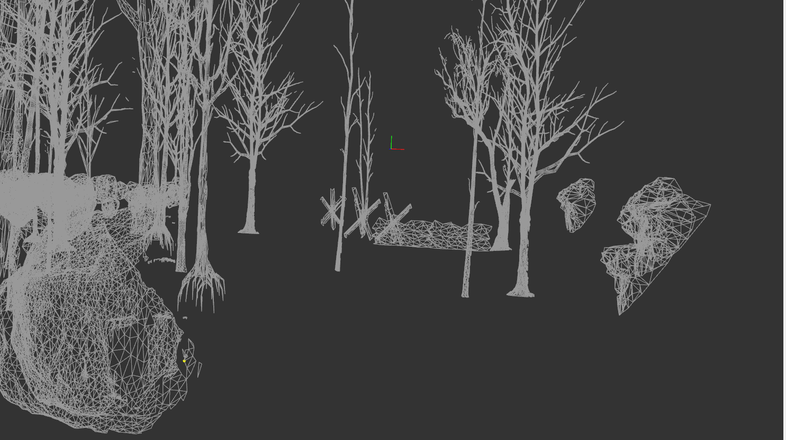
SURF
CLUSTER
All Surfs rendered as single BATCH
© 2021 Activision Publishing, Inc.
Notes:
Before we jump into implementation of our pipeline, I would like to explain some basic terminology of our engine.
Our rendering primitives are divided in hierarchical classes:
BATCH – is a single invocation of rendering API draw (drawIndirect / drawIndexIndirect)
Composed of many SURFs
SURF
Point to different parts of meshes – where meshes as a construct, as only art facing.
Split based on their non-mergeable materials splits
Composed of many CLUSTERs
CLUSTER [AALT15]
64 triangles strip

Slide 10
GPU GEOMETRY PIPELINE PREREQUISITES
UGB – Unified Geometry Buffer
  Access to all geometry data from single shader invocation
Data preparation
  Meshes pre-chunked into triangle clusters
Hierarchical Culling
  Work items allowing progressive workload expansion
    With intermediate culling
Notes:
In order to implement a fully GPU driven pipeline, we had to do some preliminary work first.
First, we had to allow access to all geometry data from single shader invocation. Systems maintaining this access are called UGB – Unified Geometry Buffers
Then we had to provide our meshes as unified pre-generated triangle clusters.
And finally, divide all work units into a hierarchy that allows progressive workload expansion, with interstage culling.

Slide 11
Unified Geometry Buffers (UGB)
UGB - virtualized memory pool for all geometry
No more vertex streams / IA frontend usage
  Arbitrary data packing
Each surf
  Base offset into UGB data
  Resolves data via vertexID
Procedural data also part of UGB
  Reserve a memory buffer for procedurally generated data (i.e. skinned vertex caches)
Offload CPU
  draw merging and minimizes API calls
  GPU pipeline driven LOD selection and merging different LODs in same draw call
Notes:
UGB is a virtualized memory pool for all geometry. It basically makes our rendering bypass standard vertex streams and input assembly in favor of manual software vertex data resolve.
This allows multiple new optimizations and extensions such as arbitrary data packing.
For each surf we keep a base offset into UGB data, that is used during data resolve via vertexID.
Procedurally generated data is also part of UGB. It is using a special memory buffer to store procedurally generated data in format matching baked UGBs – in order to provide unified vertex data interface.
Resolving all vertex data loads in software, allows bypassing regular API calls necessary for front end setup – in effect significantly offloading CPU load.
Furthermore, it allows LOD management and merging of drawcalls for different LODs – because data loads are generated on the GPU via the geometry pipeline.
It is worth noting that there is additional performance cost associated with losing IA frontend on some platforms, but we didn’t observe performance degradation in practice.
Same can be said about manual data resolve via vertexID.
You can see how easy it is to use shader facing API in our bonus slides
UGB Shader Facing API
UGB VIRTUALIZATION SHADER IMPLEMENTATION

Slide 12
UGB Implementation
Mesh Data
[HDD]
Storage->DRAM Copy Job
[DMA]
Mesh Data
[DRAM]
DRAM->VRAM Copy Job [CPU]
Load mesh into main memory from storage
Maintain virtual page table on GPU
Software allocate pages on GPU for new mesh
Upload new mesh pages into GPU UGB physical memory cache
Maintain residency and evictions
GPU Software Page Table Fixup
[GPU]
GPU Software Page Table
Sized to contain all meshes in the game
  Physical GPU buffer with visible mesh subset
Page 0
Page 1
Page N
Notes:
Let’s look at data flow in UGB implementation.
<click>
First we have the mesh stored on drive
<click>
Requested mesh data gets copied from storage
<click>
To DRAM using DMA job
<click>
Then another CPU job gets kicked off to copy that data to GPU accessible memory
<click>
This process results in filling some pages of a large physical GPU UGB buffer, with visible mesh subset.
<click>
At the same time, we need the GPU to update a Software Page Table, to correctly manage all pages in this giant buffer. The page table is sized to be able to contain all meshes in the game, throughout lifetime of the executable (otherwise you would need to do manual garbage collection)

Slide 13
UGB UMA implementation
Mesh Data
[HDD]
Storage->DRAM Copy Job
[DMA]
Consoles offer Unified Memory Architecture
GPU is backed by same Virtualization mechanism
Instead of maintaining software virtualization rely on HW implementation
Cuts down copies and total memory requirement
  At more often virtual page table updates
Strike balance between page size and per-frame page table update count
CPU/GPU Software
Page Table
Sized to contain all meshes in the game
  Physical CPU/GPU buffer with visible mesh subset
Page 0
Page 1
Page N
Notes:
In case of consoles and certain other devices, we have Unified Memory Architecture which significantly simplifies UGB management.
GPU is backed by same Virtualization mechanism as DRAM – because those memory subsystems are share.
First couple steps of the pipeline are the same
<click>
<click>
<click>
With the caveat that there is no dedicated VRAM copy step.
Also, instead of maintaining software virtualization, we rely on HW implementation
<click>
And just update global page tables
This setup cuts down copies and total memory requirement at the cost of frequent virtual page table updates.
Certain platforms have high cost of virtual page table updates thus one needs to strike balance between page size and per-frame page table update count.

Slide 14
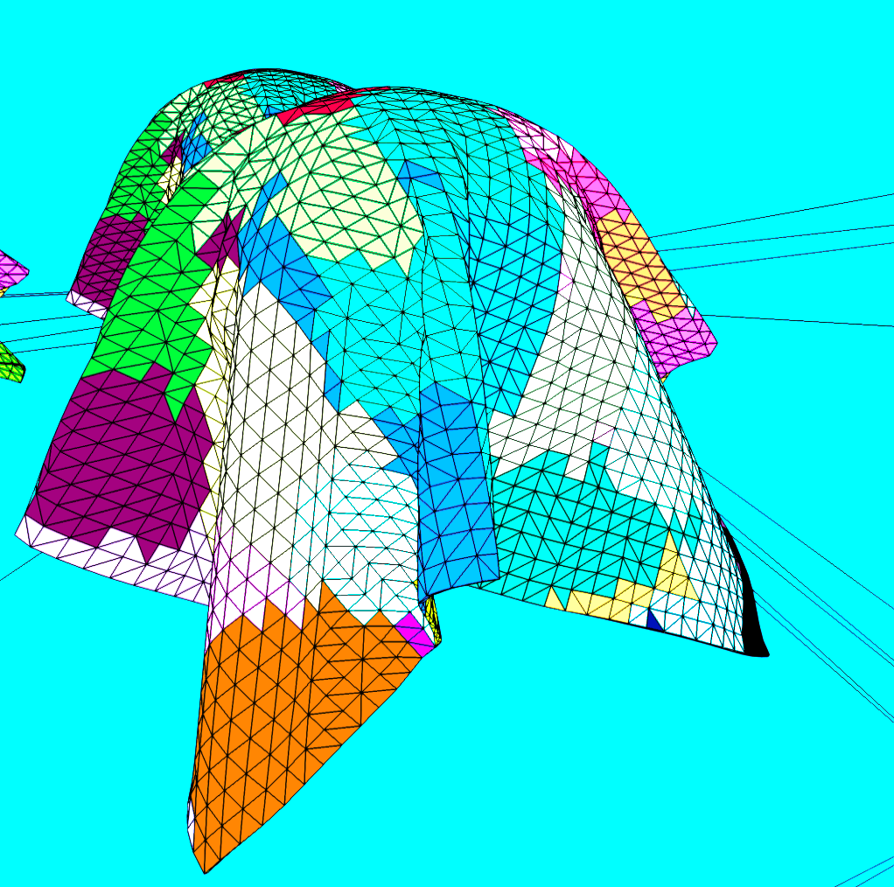
Mesh DATA preparation
Mesh converter
  Cuts mesh into 64 triangle chunks
  Optimize for
    Index range
    Position Locality
    Normal Locality
  Fill up reminder with invalid triangles
Generate
  Cluster Cull Data
  Cluster Compression Data
  Cluster Vertex Payload
© 2021 Activision Publishing, Inc.
Notes:
Another important step is mesh data preparation, that happens inside our mesh converter.
Each mesh is cut into 64 triangle sized chunks.
Those are optimized for index range, position locality and normal locality. Any reminders are filled with invalid degenerate triangles.
Converter generates additional data payloads:
Cluster cull data, Cluster compression data and cluster vertex payload

Slide 15
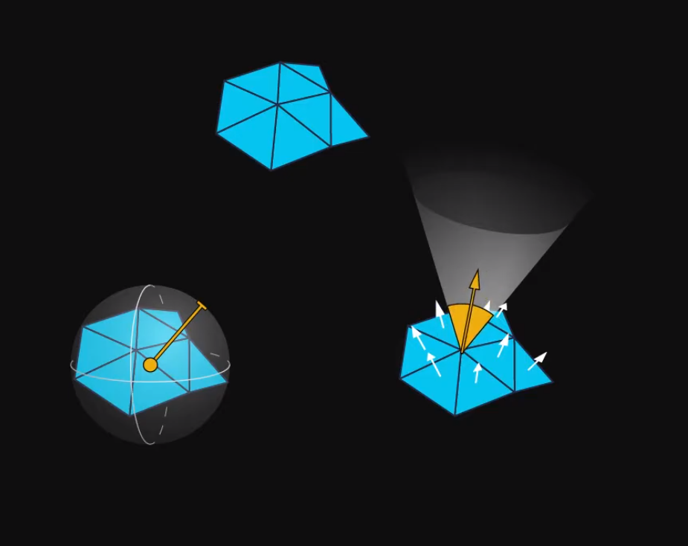
Mesh DATA preparation
Cluster Cull Data
  Bounding Box
  Cone of Occlusion
© 2021 Activision Publishing, Inc.
struct MeshClusterCullData
{
float3 midpoint; // BBox position
float3 halfSize; // BBox size
uint coneCenter; // quantized cone center offset to BBox 101010b
uint coneAxisConeOpening; // quantized cone axis 888b + 8b opening angle
}
Notes:
Cluster cull data consists of bounding box and cone of occlusion.
Cone of occlusion is generated by fitting a minimum aperture cone over all face normal within cluster.
Both pieces of data are heavily quantized and compressed.

Slide 16
Mesh DATA preparation
Index buffer for Cluster
Cluster Compression Data
  Allow variable size of each cluster data payload
    At cost of direct pointer storage to data payloads
  Mesh can be optimized within cluster range
    Quantize indices against min index in cluster
      Delta encoding
      For decompression convenience use multiples of byte
    Quantize positions against cluster BBox
      Can be tricky for mesh watertightness
        Need to take care for quantization
76 | 78 | 79 | 76 | 80 | 81 | 81 | 80 | 82
Min index value: 76
Max index delta: 6
Delta Bits : 4
Indices stored as 4-bit offsets
0 | 2 | 3 | 0 | 4 | 5 | 5 | 4 | 6
struct MeshClusterHeader
{
uint indexBufferOffset : 24; // meshes have up to 64k indices
byte indexBufferBitRange : 4; // bits needed to encode delta indices
byte positionQuantizationBitRange : 4; // bits needed to encode delta post offsets
}
Notes:
Cluster compression data is a data header that describes how a specific cluster was compressed.
It allows variable size of each cluster data payload at cost of direct pointer storage to data payloads.
Mesh can be optimized within cluster range.
First we can compress index data using delta compression,
Find minimum index within cluster, and then use it as an offset to all indices stored in cluster.
Now all indices can be stored as offsets to the first index, quantized such as they can cover maximum index distance within the cluster itself.
For decompression convenience we use multiples of byte.
We can use similar logic for position quantization against cluster Bbox.
This can be somewhat tricky, due to mesh watertightness – therefore special care needs to be taken for quantization on device rendering precision.

Slide 17
struct GPWorkgroupArgs
{
uint elemID;
uint workgroupID;
};
GPWorkgroupArgs GP_UnpackWorkgroupArgsFromUint( in uint packedArg )
{
GPWorkgroupArgs workgroupArg;
workgroupArg.elemID = GET_USHORT( packedArg, 0 );
workgroupArg.workgroupID = GET_USHORT( packedArg, 1 );
return workgroupArg;
}
uint GP_PackWorkgroupArgsToUint( in GPWorkgroupArgs workgroupArgs )
{
uint packedArg;
packedArg = MAKE_USHORT_PAIR( workgroupArgs.elemID, workgroupArgs.workgroupID );
return packedArg;
}
Notes:
Now we can move to definition of our workgroups and hierarchies.
Workgroup is a basic unified unit of work in our GPU Pipeline
It contains 64 items worth of work.
Each stage operates on workgroups, first processing them, and then expanding to next level of hierarchy.
The rough order would go like this:
Batches->Models->Clusters->Triangles

Slide 18
// In general workgroupID won’t need all bits
// i.e. below is the case for workgroup representing collection of clusters
// meshes use 16bit indices -> max cluster count = 1k
// remaining bits can be reused for next level of processing per workgroup arguments
#define CLUSTER_ID_MASK 0x3FF
#define TRI_CULL_BIT_SHIFT 10
#define CLUSTER_SURF_IS_SHADOW_BIT_SHIFT 11
#define CLUSTER_SURF_VISBUF_BIT_SHIFT 12
uint GP_UnpackClusterIndexFromID( uint workgroupID )
{
return workgroupID & CLUSTER_ID_MASK;
}
bool GP_UnpackTriCullEnabledFromID( uint workgroupID )
{
return !!( ( workgroupID >> TRI_CULL_BIT_SHIFT ) & 1 );
}
bool GP_UnpackClusterSurfUseVisBufFromID( uint workgroupID )
{
return !!( ( workgroupID >> CLUSTER_SURF_VISBUF_BIT_SHIFT ) & 1 );
}
Notes:
Final per-frame unit of work is a workgroup representing a cluster of triangles, stored as uint64 – with each bit representing a single triangle.
No stage ever needs all bits, therefore some bits are used as per-workgroup arguments for next stage processing.
There are multiple stage related bit packing and unpacking APIs we use, in order to repurpose workgroups.

Slide 19
Runtime DATA preparation
CPU multi threaded batch creation jobs
  Generate static model (sModel) run time collections
  sModels have transform data precomputed
  sModels sharing materials prebuilt as AABB hierarchy
  Runtime
    Rough culling
    LOD range selection for collection
    Memory residency check
    Concatenate same materials into single batch (draw call)
  Generate a reverse lookup table that matches sModels to materials and common batches (draw calls)
    For each sModelIndex store batchID and materialID
    GPU gets access to material data relevant to culling
    Different surfs concatenate to same material draws
    Resolve and fill indirectArgs matching CPU draws
Notes:
Initially CPU used to handle model culling and LOD selection. However, in a world of mass instancing and increasingly complex LOD logic, this quickly became the bottleneck.
We were looking for a way to offload all this complex logic to GPU, thus introduced simplified model collections and simple hierarchies.
CPU kicks of multi threaded batch creation jobs.
They generate static model (sModel) run time collections.
sModels have transform data precomputed,
All sModels sharing same materials are furthermore prebuilt into AABB hierarchies.
We can use them at runtime for:
- Rough culling
- LOD range selection for collection
- Memory residency check
- Concatenate same materials into single batch (draw call)
CPU jobs also generate a reverse lookup table that matches sModels to materials and common batches
- For each sModelIndex store batchID and materialID
- GPU gets access to material data relevant to culling
- Different surfs concatenate to same material draws
- Resolve and fill indirectArgs matching CPU draws
All this data is stored at various levels of multiple hierarchical structures that you can check out in bonus section (SModelCollExpansionArg)

Slide 20
Runtime DATA preparation
CPU multi threaded batch creation jobs
  Similar pre-processing happens for all other entity types
    xModels (movable models)
      Dynamic models have all transform data generated on the fly
    Clutter (procedurally spawned models)
      Procedural placement data type
      References a set of given sModels and scatter parameters
        GPU jobs generate transform data on the fly
        GPU jobs generate GPU Pipeline consumable data similar to sModel collections
    Skinned Models
      Provide intermediate data buffers for vertices (skinned caches)
    Other exotic model types
      Follow skinned model paths for pre-caching
      Or opt out from GPU pipeline
Notes:
We run a very similar process for dynamic moveable models.
The main difference is that we need to generate all transform data on the fly and generate unified input data for multiple different types of dynamic geometry.
This covers standard dynamic rigid models and procedurally placed models such as clutter – which is our dynamic placement system for foliage and small decorator meshes.
Models that are deformed or generated on the fly, need a bit more attention.
Skinned models output transformed vertices into intermediate data buffers that are read by gpu pipeline as if they were part of static data.
Other exotic model types use similar caching mechanisms or opt out of gpu pipeline.

Slide 21
Culling intermediate format : VIS BIT MASKs
Index buffer for Cluster (192 indices)
Stages use 64b bitmasks as intermediate cull data
  Surf/Cluster/Triangle culling workgroup
    Operates on 64 surf/clusters/triangles at same time
    Nth bit indicates Nth valid surf/cluster/triangle
Optimizes reduction algorithms
  Bitmask operators
Allows multi-stage / multi-view merging and pruning
  Use binary operators AND / OR
Optimizes memory bandwidth and storage
  Keep visBitMasks persistent throughout the frame
  Expand to index buffers on demand
    Source data or indices can be highly compressed
76 | 78 | 79 | 76 | 80 | 81 | 81 | 80 | 82
Tri buffer for Cluster (64 triangles)
Tri0 | Tri1 | Tri2
Tri visibility mask with Tri1 culled
101
Notes:
All stages use visibility binary masks stored as uint64
They are used to represent intermediate culling data for each entity stage.
This optimized for of data processing allows multiple interesting algorithms – i.e. fast binary operations when processing multiple views
It becomes efficient and trivial to find sums or intersections of triangles from multiple views.
Furthermore, it allows us to minimize memory bandwidth and storage required throughout the frame as we only need to store one bit per triangle.
Then index buffers are expanded from bitmasks on-demand.
This on-demand expansions also allows us to store source index data in highly compressed form.

Slide 22
Pipeline Setup : EXPANSION
CPU Jobs collect model batches
CS Expansion To Surfs
CS Surf Culling and LOD selection
CS
Expansion to Clusters
BatchData Gen Stage
SurfData Gen Stage
SurfData Gen Stage
Cluster Gen Stage
ClutterData
DynSurf
DynSurf
Clusters
/w surfID reference
sModelCollections
SModelSurf
SModelSurf
xModelData
skinnedModelData
CS
Compaction
Notes:
Let’s go through our workgroup expansion pipeline step by step.
<click>
We start with CPU jobs collecting model batches
<click>
This step generates BatchData for multiple input geometry types
<click>
Followed by CS job that expands BatchData to Surfs at which point multiple input batches become expanded and unified to dynamic surfs and statis surfs.
<click>
This is followed by CS job that does Surf culling and LOD selection
<click>
Outputting culled SurfData
<click>
Next step runs CS compaction job on culled SurfData
<click>
And finally there is a CS job that expands sufs into triangle clusters
<click>
Generating workgroups representing clusters along with their original surface ID references

Slide 23
Pipeline Setup : CULLING
Cluster Stage
Depth Sorted Cluster Workgroups Indirection Buffer
Triangle Stage
CS
Compaction
Clusters
Triangle VisBitMask
CS Cull Clusters
CS
Cluster Depth Sort
CS
Triangle Cull
Triangle Stage
Triangle VisBitMask
CS
Triangle Index Expand
Cluster Stage
Cluster Stage
Triangle Stage
Clusters VisBitMask
Clusters VisBitMask
Triangle workgroups
CS
Compaction
CS Cluster
Expansion to triangle workgroups
VS Triangle Stage
Triangle Index Data
Non-Indexed Draws
Notes:
Now we can move to final stage that operates on clusters of triangles and triangles.
<click>
We start with cluster stage data.
<click>
That goes through a CS cluster culling job
<click>
Generating cluster visBitMasks
<click>
That get compacted
<click>
And stored
<click>
Now we can move to triangle processing.
<click>
A CS job expands clusters into triangle workgroups
<click>
Followed by another job that does triangle culling
<click>
Generating final culled triangle visBitMasks
<click>
Next step is another compaction job>
<click>
Generating final triangle visBitMask buffer, ready for on-demand index expansion
<click>
Triangle Index Expansion job can however alter the ordering of final triangles at cluster granularity
<click>
Going back to cluster stage, we can have a CS job that does cluster depth sorting
<click>
Which generates a depth sorted cluster workgroup indirection buffer – in our case in front-to back order for efficient drawing of opaques, or back-to-front order for transparent triangle clusters
<click>
This data can be finally consumed by Triangle Index Expand job
<click>
To generate, potentially semi-sorted, triangle index buffers for indexed and non-indexed draws

Slide 24
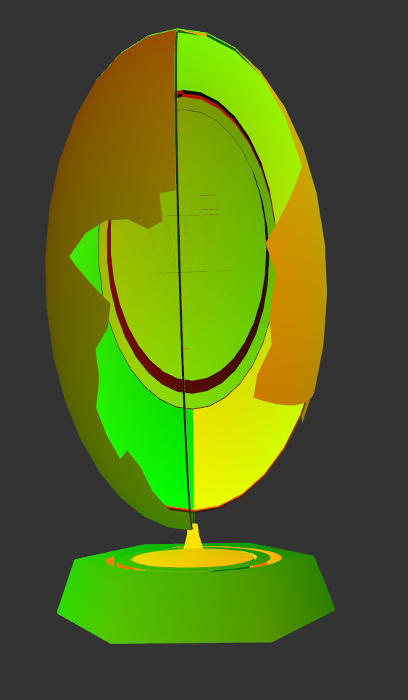
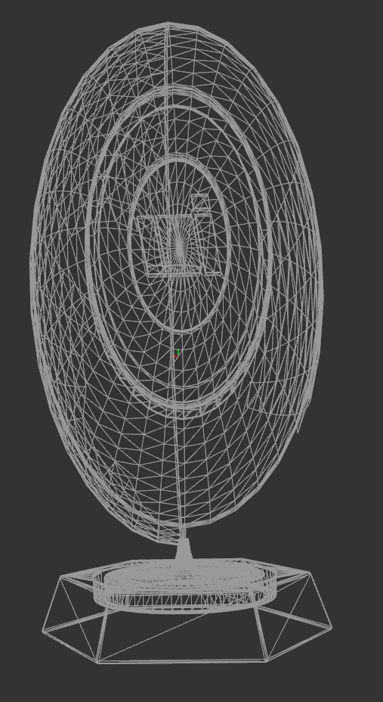

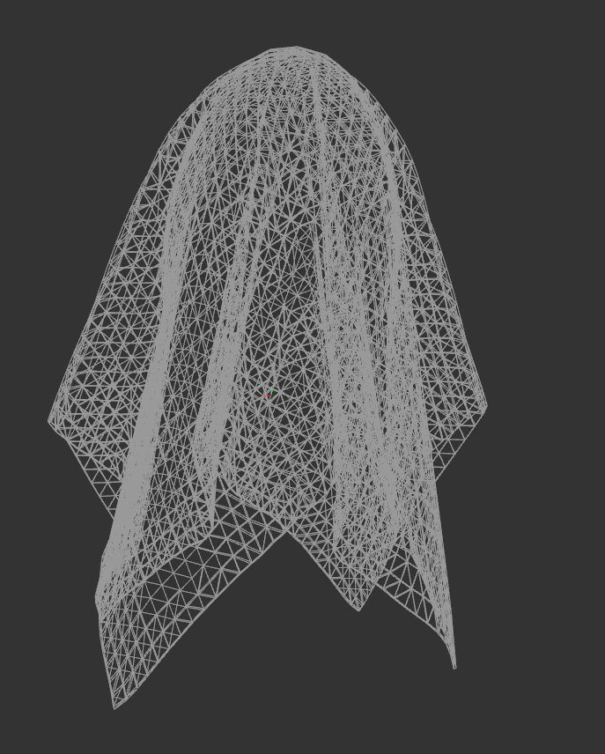
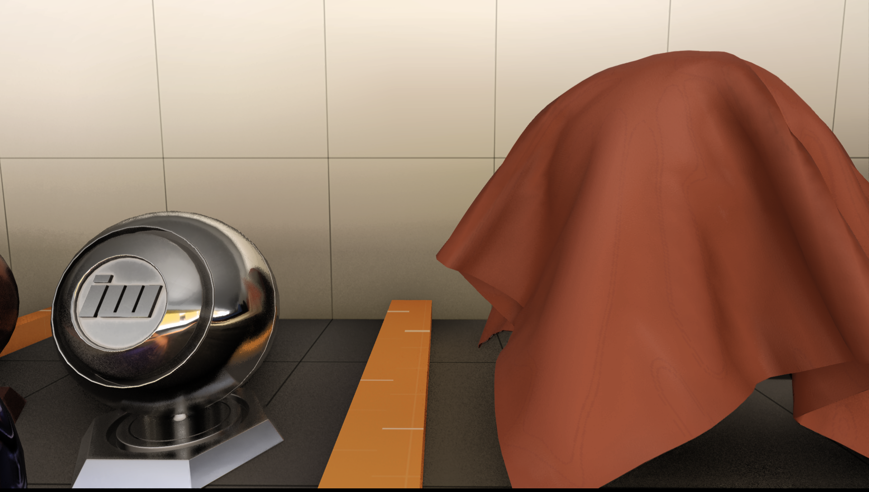
Cluster Culling
Cull testing
  Frustum
  Degenerate
  Missing sampling point
  Cone Occlusion
    Test if all triangles could be back facing
Occlusion cull
  Pre-pass uses CPU generated depth buffer
    Umbra 64x64 resolution
  For transparencies we use hierarchical depth buffer
Base 28k tri
Cluster Cull 24k tri
Base 32k tri
Cluster Cull 30k tri
© 2021 Activision Publishing, Inc.
© 2021 Activision Publishing, Inc.
Notes:
Now let’s quickly move to cluster culling overview.
We utilize fairly basic culling tests:
Frustum to test if triangles would end up inside the frustum
Degenerate to test if a cluster didn’t end up malformed by transforms
Missing sampling point to test if a cluster would have a chance to actually render
Cone occlusion to test if all triangles would be backfacing
Furthermore, we have optional occlusion culling pass
For pre-pass we use CPU generated depth buffer of the scene
For transparencies we use hierarchical depth buffer of the scene , generated from the prepass depth
Both tests use cluster bounding box check against aforementioned depth sources.

Slide 25
Cluster/TRIANGLE Compaction
For all cluster workgroups
  Multi Pass Parallel Prefix Sum
    Compacted Workgroup array of surviving clusters/triangles
  Generate Indirect Draw Args for next pass
Clusters VisBitMask
Offsets
Args Count
00001010
00100000
00000100
0,2,3
4
countSetBits
2
1
1
Parallel Prefix Sum
Notes:
Compaction steps are shared between different workgroup types.
<click>
Each workgroup uses a visBitMask
<click>
That is first counted <click>
<click>
and then processed by parallel prefix sum
<click>
outputting data for indirect draw or indirect dispatch arguments as well as offset buffers to surviving blocks of entities.

Slide 26
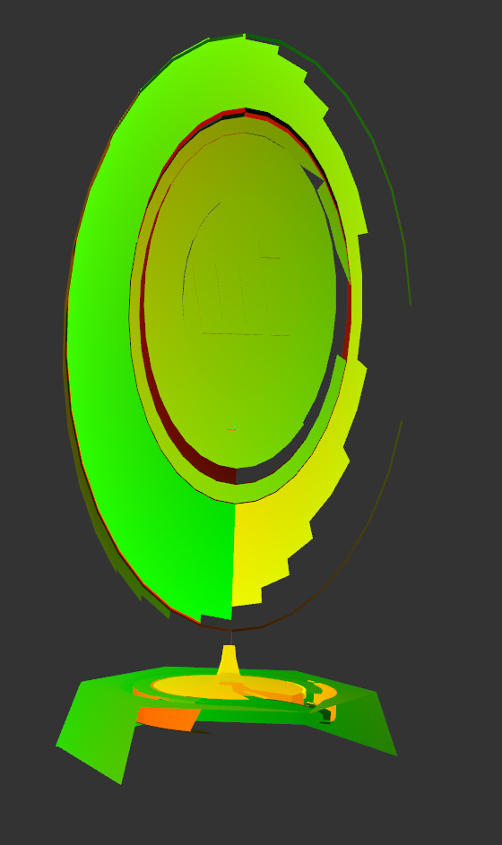
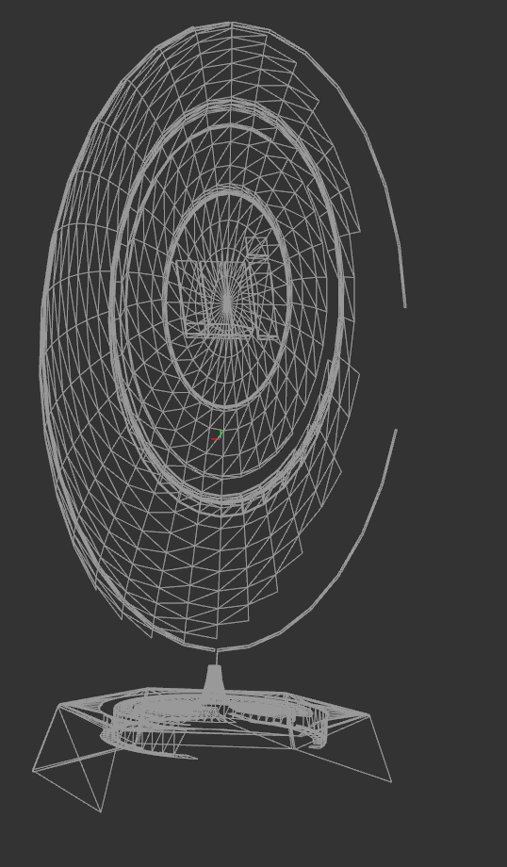
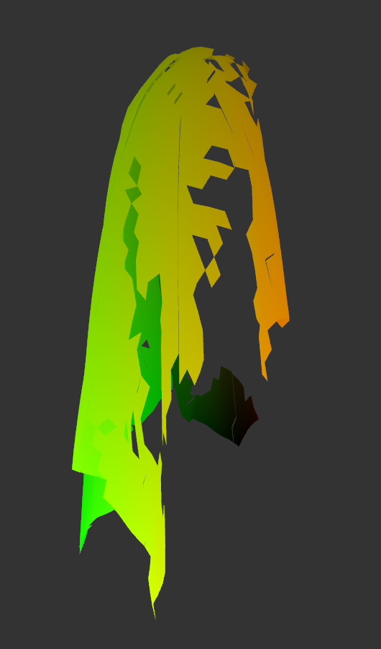
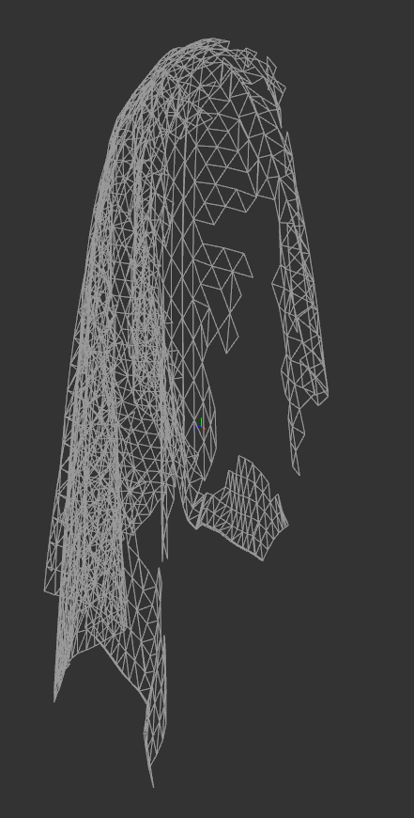
TRIANGLE CULLING
Cull testing
  Back face
  Frustum
  Degenerate
  Missing sampling point
Optional occlusion cull
  Pre-pass uses CPU generated depth buffer
  For transparencies we use hierarchical depth buffer
  Visibility buffer fine culling
Base 28k tri
Cluster Cull 24k tri
Triangle Cull 14k
Base 32k tri
Cluster Cull 30k tri
Triangle Cull 7.2k tri
© 2021 Activision Publishing, Inc.
© 2021 Activision Publishing, Inc.
Notes:
Triangle culling is similar to cluster culling.
Occlusion pass can use same data as cluster culling.
One big addition to triangle culling is our visibility buffer fine culling that we will be discussing in a minute.

Slide 27
Triangle INDEX Expand Pass : resolve
Depth Sorted Cluster Workgroups
Reads triangle workGroups and their visMasks
Read can happen in sort order
  Use sorted indirection table
Compact
Decompress indices from storage
Write out indices to VS consumable format
00001010
00100000
00000100
Compact
MeshClusterHeaders
Decompress Index Data
11
1
1
MeshClusterIndices
VS Consumable Index Buffer
3 4 5 | 80 81 82 | 91 92 93 | 93 94 95
Notes:
Final stage reads all triangle workGroups and their visMasks.
Read can happen in sort order, using indirection sort table.
Then indices are decompressed from stored mesh cluster index data, compacted on-the-fly and written out to Vertex Shader consumable format.

Slide 28
Triangle INDEX Expand Pass : output
Indexed Draw Data
3 x 32b
surfaceID | triangleID
Lit Pass
Indexed
Indirect
Draw
CS
Triangle Index Expand
Non-Indexed Draw
1 x 32b
workGroupID | triangleID
Prepass
Indirect
Draw
Notes:
Triagle Index Expand job generates 2 output types of Vertex Shader consumable data.
<click>
One for Indexed Draws, used for F+ lit passes.
Those draws consume:
3 x 32bit Indices
Each index is stored as: surfaceID | triangleID (16b | 16b)
<click>
VS reads input directly via SV_VertexID and extracts 16bit surfaceID to load surfaceData
<click>
And another output is for Non-Indexed draws, used for V+ prepass.
Those draws consume:
1 x 24bit workGoupID (cluster) + 1 x 8bit triangle ID in workgroup
<click>
VS needs to indirectly resolve triangleID and surfaced.
To minimize the bandwidth - 3 vertices are decoded from single 32b payload .
All submit draws use indirectDraw / IndirectIndexedDraw interfaces.
Therefore, they can store additional perDraw data in:
baseVertexLocation (that we use for per draw vertex offset)
startInstanceLocation (used for auxData)
Worth noting that consoles allow even more data passing.
You can see an example of vertex data loading code for various path in bonus slides (GP_InitGlobDrawData )

Slide 29
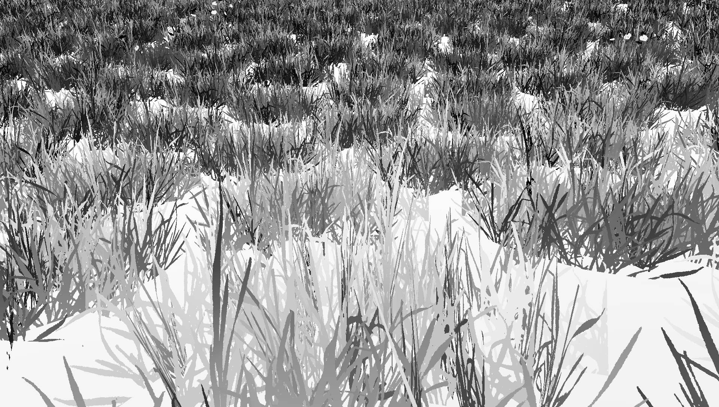

Pre-Pass Performance : 64 BIT dATA + 32 BIT Depth
Heavy alpha test scene
Mpix | Prepass VRS | Prepass | Total ∆(ms) | Total ∆(%)
2 | 1.7 | 2.4 | 0.7 | 29%
1 | 1.36 | 1.7 | 0.34 | 20%
Balanced geometry scene
Mpix | Prepass VRS | Prepass | Total ∆(ms) | Total ∆(%)
2 | 2.04 | 2.3 | 0.26 | 11%
1 | 1.67 | 1.75 | 0.08 | 5%
© 2021 Activision Publishing, Inc.
Notes:
Our Visibility buffer stores different data depending on draw type.
We will go into details a bit later. The important thing now is that data can use up to 64bits per pixel, making pre-pass expensive.
Using our VRS pipeline allows to significantly improve pre-pass performance.
Due to 4xMSAA at half resolution rendering, shader invocations are cut by up to 75%
The negative side effect is duplication of non-edge pixels.
This is a non-issue for triangle ID (as it is coherent on per-triangle basis), but other data, such as Uvs, need to be reconstructed and potentially interpolated if stored directly in Visibility Buffer.
Here you can see some performance numbers for usage of our VRS MSAA pipeline. There are clear gains ranging from 5-30% depending on how heavy the prepass shaders are – helping the most with heavy alpha test overdraw.

Slide 30
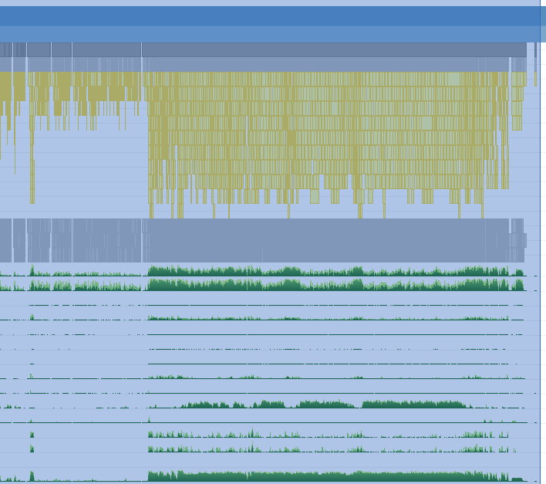
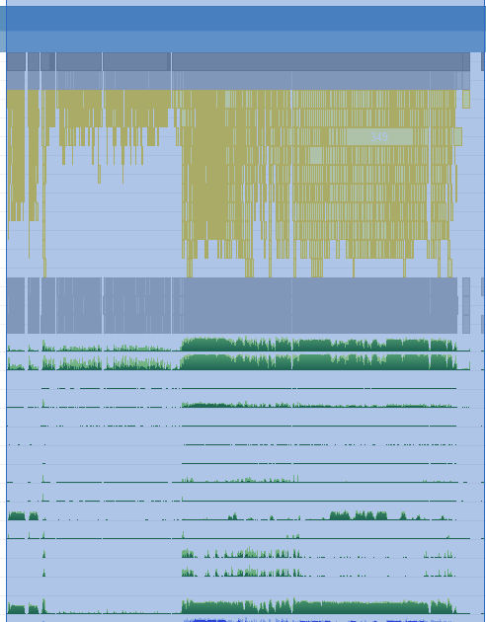
Draw call wavefront timings
perPixel 2.4ms
perPixel 4xMSAA 1.7ms
Notes:
Here you can see a comparison of non-MSAA prepass vs. MSAA prepass for aforementioned scene.
As you can see, MSAA with manual SV_COVERAGE unroll results in significantly less waves, thus less pressure on PS Export Allocation, resulting in shorter execution time.

Slide 31
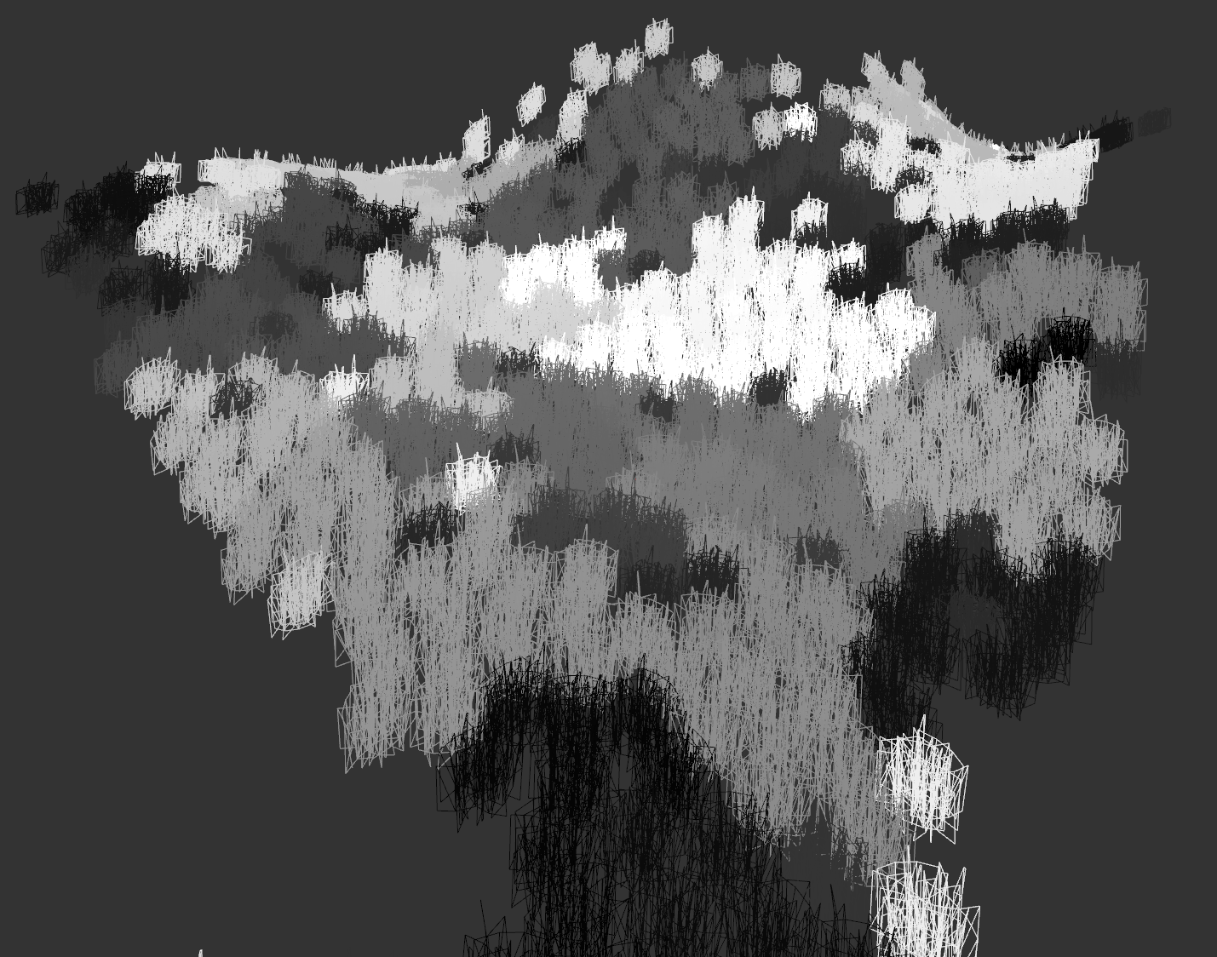
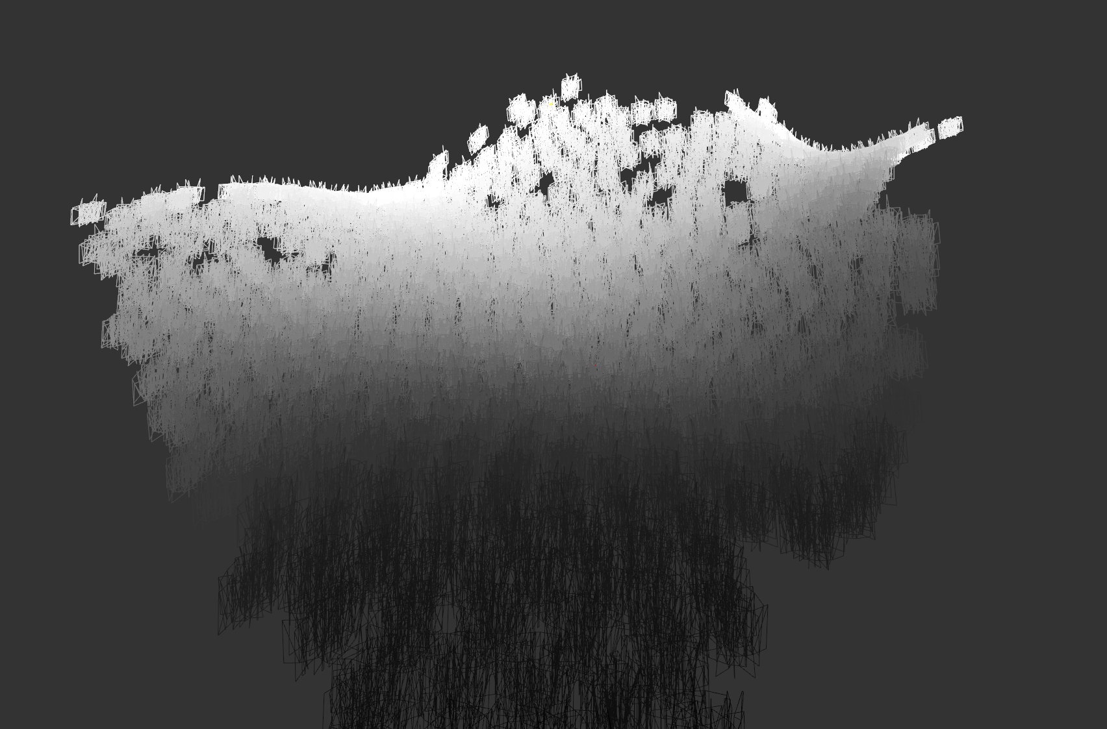
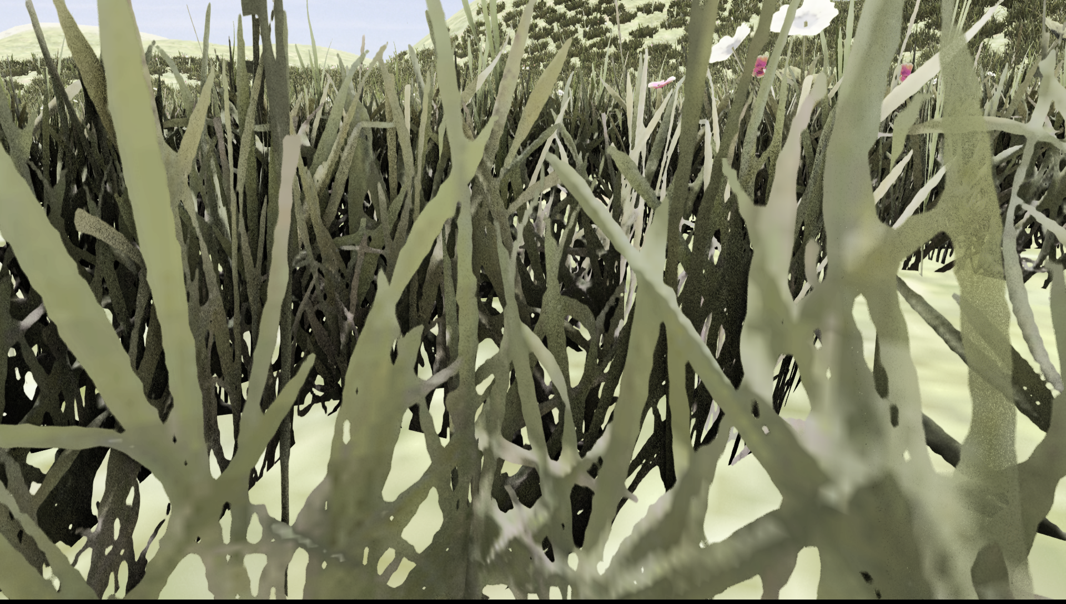
visibility buffer Optimization :
SORTING
Unsorted
Sort clusters front to back in order to maximize Early-Z benefits
  CS Radix Sort generates re-ordering table for clusters
    Re-ordering table used only in index buffer expansion pass
  can only be done for clusters from same draw
No guarantee it will render in order but gives a higher probabilistic chance of more efficient Early-Z
Sorted
© 2021 Activision Publishing, Inc.
© 2021 Activision Publishing, Inc.
Notes:
Arguably our alpha tested rendering has always been optimized. We used multiple techniques throughout our projects:
Depth prepass with depth equal for lit
Convert high resolution alpha maps to SDF
Prebake optimized index buffers for bushes and trees, for multiple viewpoints.
But even with all those optimizations, rendering dense foliage is a challenge.
Main problem with alpha test is overdraw in prepass that is exacerbated by most GPU optimizations being off when rendering with alpha test.
In order to give the GPU a chance to cull anything, we need to make sure it renders in front to back order as tightly as possible.
Therefore, during cluster processing, run Radix Sort Compute Job, that generates a re-ordering table for clusters.
This table is used only in index buffer expansion pass, which allows us to output all triangle clusters in correct order.
Unfortunately, there is no guarantee that triangle will really render in-order but pre-sort gives a higher probabilistic chance of more efficient Early-Z culling.

Slide 32
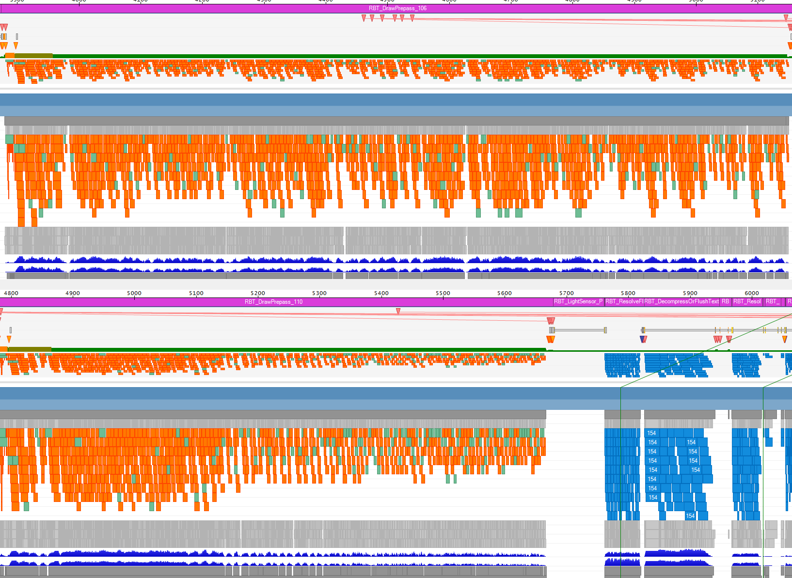
visibility buffer Optimization : SORTING aLPHA TESTED
Test 1 : Unsorted vs Sorted
Sorting OFF
Pre-pass | Time (ms) | Pixels Processed
Sorted Atlas | 1.6 | 5374458
Unsorted | 1.8 | 4527530
Delta (%) | -25% | -15%
Test 2 : Single draw : Sorted Bindless vs Sorted Atlas
Sorting (Non-Bindless) ON
Pre-pass | Time (ms)
Sorted Bindless | 8.7
Sorted Atlas | 8.4
Delta (%) | -4%
© 2021 Activision Publishing, Inc.
Notes:
Alpha tested geometry is a prime candidate for sorting optimization due to high PS cost.
Almost all alpha tested geometry uses same shader permutation, therefore we can submit all in one draw via automated merging.
However, this approach forces us to use bindless texturing which has a non-trivial cost on GCN GPUs.
GCN architecture needs to scalarize texture and sampler descriptors, which not only results in significant slowdown on divergence, but also can result in suboptimal code generation.
We found out that sorting cost and added cost from bindless textures outweighs the benefit of Early-Z.
However, if we could avoid the cost of bindless (i.e. via content preparation to use atlases or using a different GPU architecture that doesn’t have the penalty of bindless) we can see very clear performance wins.

Slide 33
visibility buffer Optimization : SORTING NON-ALPHA TESTED
Non-alpha tested geometry
  Can submit all in one draw via automated merging
  Cost of uber-shader
    Must include deformations and animation support
    Cost of uber-shader for all different geometry types
    Cost of uber-shader for all different PS features (i.e., dither blend)
  Sorting cost and added cost from uber-shader outweighs the benefit of early Z
    PS are not expensive enough
      Even writing out 64bit V-Buffer
  Arguably hard to find game content scenes with extremely high opaque mesh overdraw
    Assuming there is any kind of coarse occlusion culling
Notes:
We also tried sorting of non-alpha tested geometry.
Again, we started by rendering it using a single uber-shader via automated merging.
Unfortunately, we found out that sorting cost and added cost from uber-shader outweighs the benefit of early Z.
Prepass Pixel Shaders are just not expensive enough.
Furthermore, based on our experience, it is hard to find game content scenes with extremely high opaque mesh overdraw, assuming there is any kind of coarse occlusion culling.
Lack of overdraw make this technique somewhat less useful for non-alpha tested geometry.

Slide 34
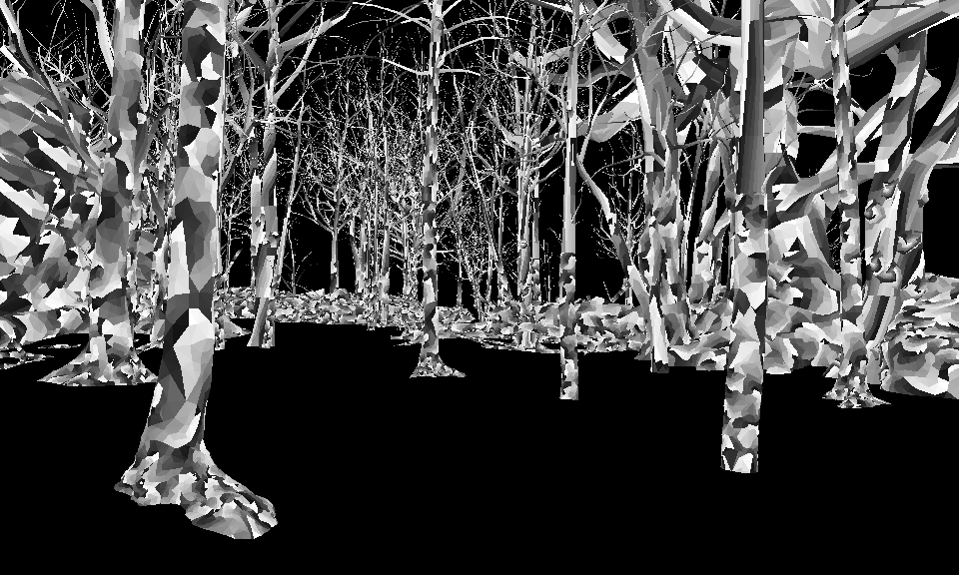
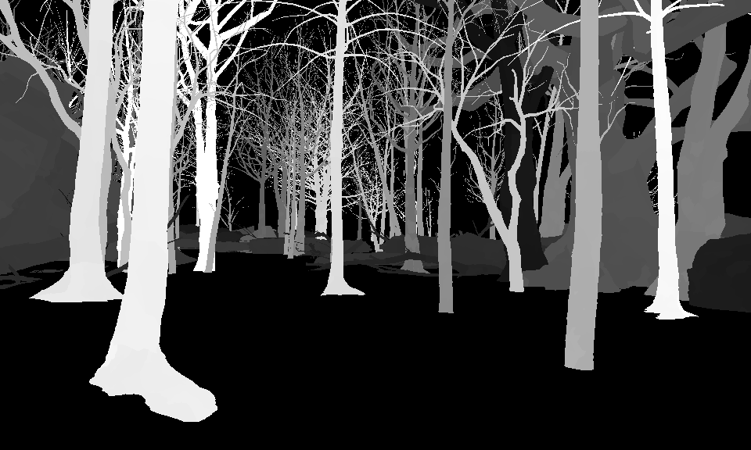
PREPASS shading
triangleID % 0xFF
Fill out visibility buffer triangleID
  Disable indexed rendering
    Indexed draws have vertices shared between triangles
      No way for consistent unique triangleID passed to PS
    Drivers on PC do it automatically when using sv_TriangleID
    Performance impact
      Offset by uber merging and other triangleID benefits
triangleID stores a lot of data
  Lookup SURF
    Lookup MATERIAL
  Visibility
    only rendered triangles are needed for further draws
F+ uses triangleID from Visiblity Buffer for fine cull
© 2021 Activision Publishing, Inc.
surfaceID from triangleID
© 2021 Activision Publishing, Inc.
Notes:
Let’s talk about prepass shading.
In order to fill visibility buffer with triangleID we need to have a way to actually generate triangleID in PS stage.
Indexed draws have shared vertices between triangles, therefore there is no way to have a consistent unique triangleID in PS. We explicitly disable indexing, only for draws that need to generate V+ buffer.
This is exactly what happens on PC, in the driver, when you request sv_TriangleID in PS.
This is also the reason why GPU Pipeline Index Expand Stage needs to support dual outputs : indexed and non-indexed.
triangleID per-pixel is an extremely powerful piece of information as it can be used to resolve back any kind of information that is related to a triangle that passed all visibility testing per pixel.
It can be used by multiple different algorithms as well as for fast triangle culling before F+ lit draws.
It would be interesting to have native hardware support for triangleID, potentially part of DB blocks allowing a VS only pipeline.
Let’s take a look at our F+ culling pipeline.

Slide 35
Pipeline Setup : F+ CULLING
CS
Compaction
Hierarchical Depth Buffer
Triangle Stage
CS
Depth Cull Transparent Triangles
Triangle VisBitMask
Triangle Stage
CS
Triangle Index Expand
CS
Mark visBits from triID Buffer
Triangle VisBitMask
VS Triangle Stage
triID Buffer
Triangle Index Data
Indexed Draws
Notes:
Our culling pipeline is split at the beginning depending on input data.
<click>
First we start with CS for culling of transparent triangles.
<click>
This job uses hierarchical depth buffer as input for culling and uses it for simple hierarchical triangle bounding box checks to mark triangles visbits
<click>
Then we run another CS job for opaque triangles
<click>
This job reads triangleID buffer from prepass, and uses it to directly mark surviving triangles visbits
<click>
At this point we have common processing for both paths, as both produce visbitMask for surviving triangles
<click>
Next step is a CS job that compacts it
<click>
Generating new visBitMask
<click>
Followed by CS job that does triangle index expansion
<click>
Into Vertex Shader consumable data for indexed and non-indexed draws where applicable

Slide 36
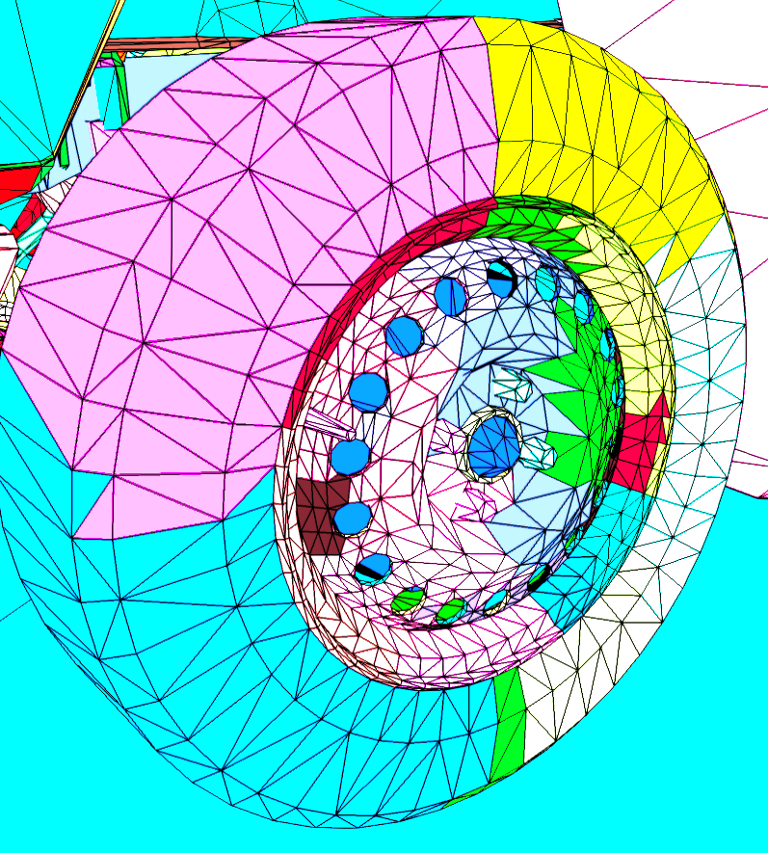
Post prepass Fine Culling
CS
Clear Surviving Triangles
Pre-Pass Triangle VisBitMask
Pre-Pass Triangle VisBitMask
Mark Triangles Scanned from triangleID
001100000
00000000
000001100
00000000
111000000
00000000
00000000
00000000
Notes:
We use visibility buffer triID to fine cull triangles before opaque pass.
<click>
First, zero out surviving triangle visBits from prepass visBitMask.
<click>
Them scan visibility buffer for surviving triangles, stored as triangleID per pixel.
<click>
Concatenate pixels from surviving triangles and mark relevant visbits in final visbit mask.
This process will result in triangle perfect culling.
Regarding performance it runs close to bandwidth speed on consoles
Degenerate scaling with triangles from different clusters in same processing tile.
If you need to read Visibility Buffer for V+ setup this comes ‘free’
MSAA VRS yields significant speed up as - 8x8 threadgroup scan up to 4 planes of 8x8 pixels using MSAA compression for bandwidth improvements.
It is worth noting that transparencies are culled with Hierarchical Depth buffer because we don’t have triangleID for them.

Slide 37
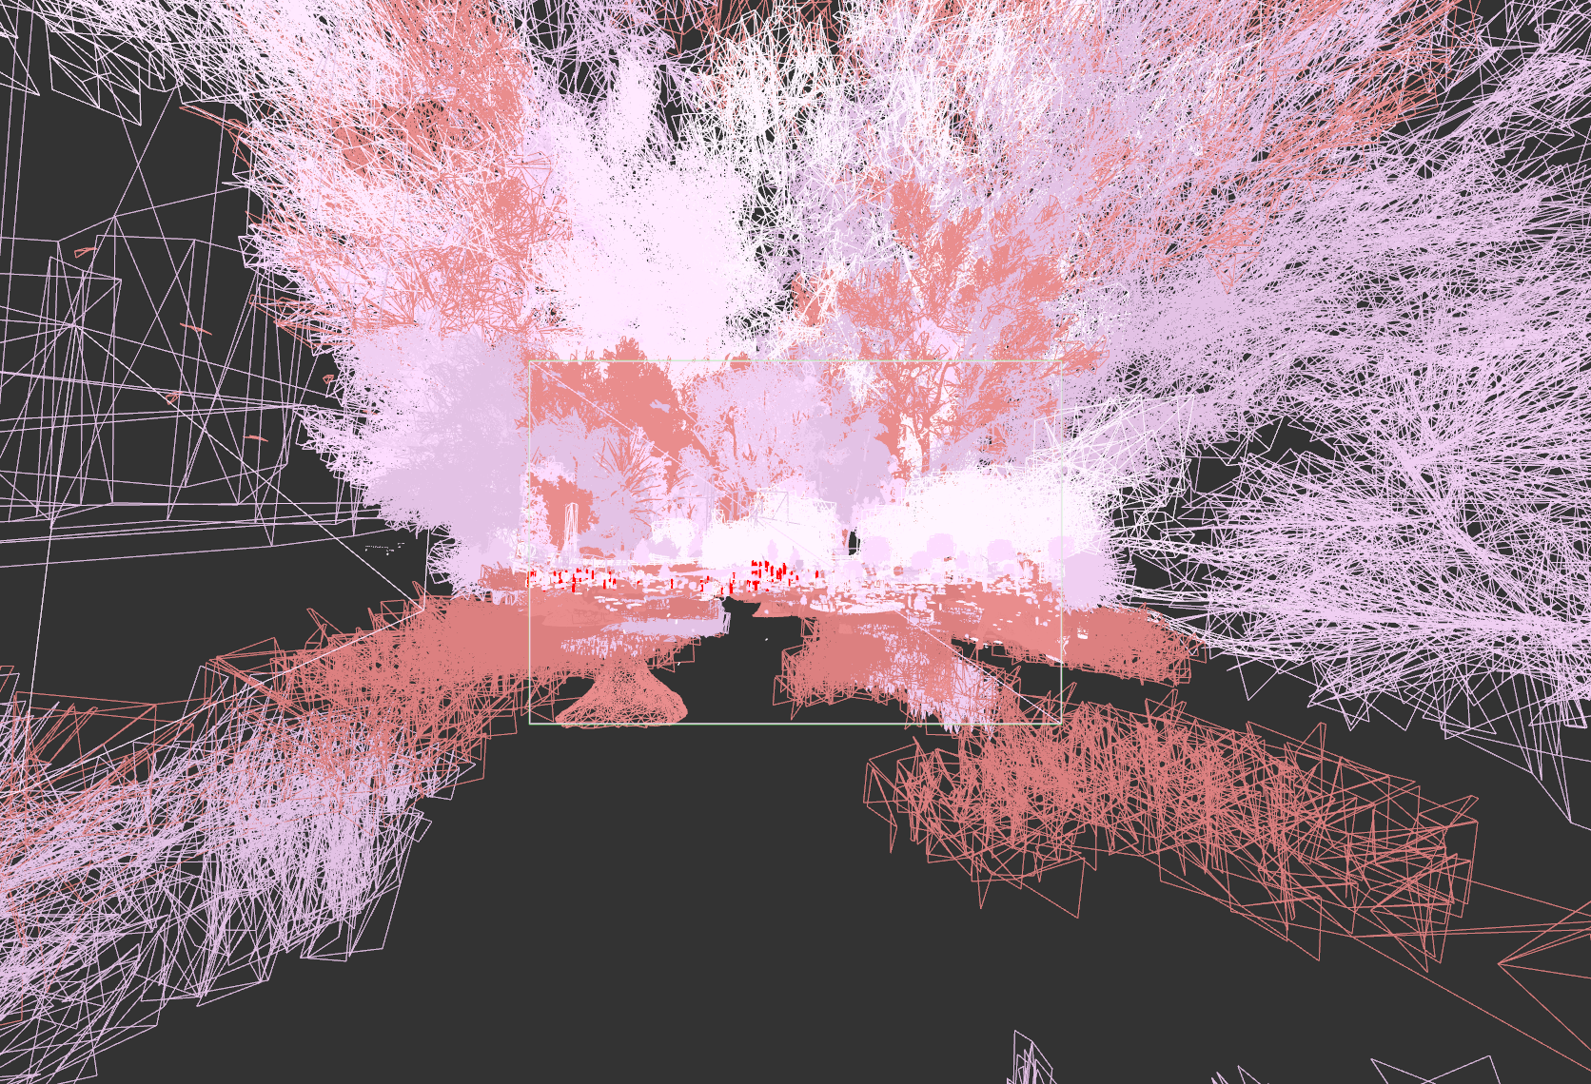
Post pre-pass Fine Culling Performance
 | Base Tri | Pre-pass Cull Cluster | Pre-pass Cull Tri | Lit Pass Depth Occ Cull Tri | Lit Pass V-Buf Occ Cull Tri
Triangles ∆(%) vs base | 2600000 (n/a) | 1906800 (73%) | 1116574 (43%) | 475600 (18%) | 85672 (3.2%)
Cost /wo MSAA (ms) | (n/a) | 0.05 | 0.8 | 1.01 | 0.21
Cost /w MSAA (ms) | (n/a) | 0.05 | 0.8 | 1.01 | 0.08
Notes:
Let’s take a look at some pre-pass fine culling performance.
This is a heavy overdraw forest scene.
Hard scenario for hierarchical depth culling due to depth porosity.
Notice that V-Buf Culling costs only 0.21ms vs. >1ms for processing all surviving triangles again and testing against hierarchical depth buffer.
Use of MSAA further reduces that cost to 0.08 ms
You can see pseudocode for visibility buffer prepass code in bonus section (vis_buffer_prepass_merge_write_tris)

Slide 38
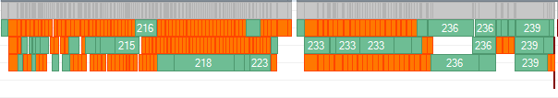
Opaque rendering : F+ with perfect triangle cull
No wasted VS work
No empty draws
No parameter cache stalls
Every draw is fully PS bound
Front load as much work as possible into VS
  Calculate GI per-vertex
  Do as much as you can per-vertex
  Can have many more interpolators
    Optimal parameter cache reservations
Notes:
Perfect triangle culling results in a lot of benefits:
There is no wasted VS work
There are no empty draws
And no parameter cache stalls
Every draw is fully PS bound
Such setup almost suggests trying to front load as much work as possible into Vertex Shader.
In general, because there is no wasted parameter cache memory, you can use more interpolators than usual.
One expensive thing we tried moving to vertex shader is global illumination.
Global Illumination resolve place in our pipeline is quite an interesting subject. Over the years we have been going back and forth between VS and PS resolve depending on triangle per pixel ratios in our titles.
Currently, with fine triangle culling it makes more sense to resolve it per-triangle. On the other hand full V+ rendering is significantly easier to implement with PS resolve. This is also why we currently keep out PS and VS GI pipelines at parity and can switch at any time per material.

Slide 39
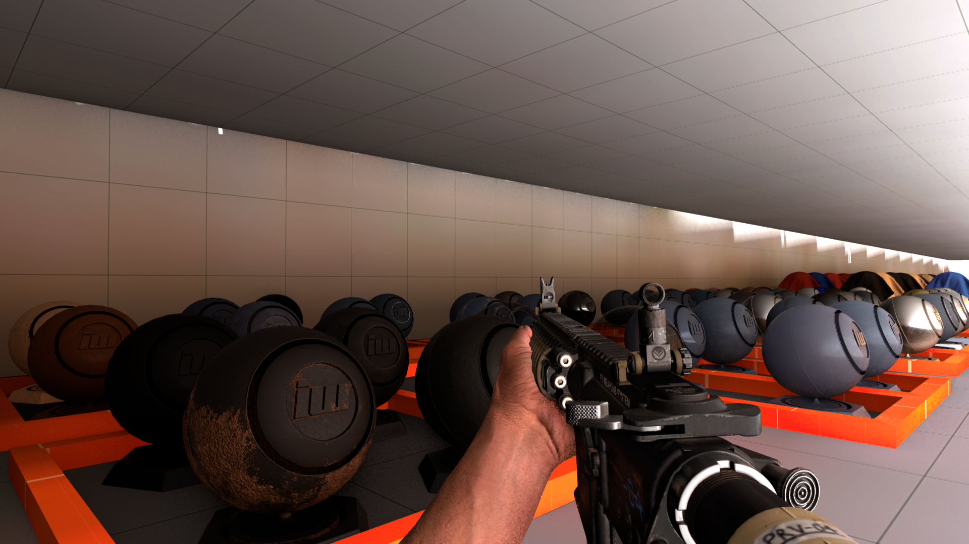
Opaque rendering : F+ with perfect triangle cull
 | Pipeline | Prepass | Opaque | Total
/wo Cull (ms) | 1.1 | 8.7 | 15.9 | 25.7 (00%)
/w HiZ Cull (ms) | 2.6 | 5.2 | 11.97 | 19.7 (76%)
/w V Cull (ms) | 1.7 | 5.2 | 9.6 | 16.5 (64%)
 | Pipeline | Prepass | Opaque | Total (ms)
/wo Cull (ms) | 0.9 | 3.3 | 7.2 | 11.4 (00%)
/w HiZ Cull (ms) | 1.5 | 1.43 | 5.3 | 8.23 (72%)
/w V Cull (ms) | 1.02 | 1.43 | 5.1 | 7.55 (66%)
 | Pipeline | Prepass | Opaque | Total
/wo Cull (ms) | 0.7 | 4.2 | 4.6 | 9.5 (00%)
/w HiZ Cull (ms) | 2.0 | 1.4 | 2.4 | 5.8 (61%)
/w V Cull (ms) | 1.1 | 1.4 | 2.25 | 4.75 (50%)
Notes:
Let’s take a look at some results from several scenes that are representative of typical game scenarios.
As you can see from our results, perfect triangle culling is a significant gain, not only in actual culling job performance, but also when it comes to F+ performance – resulting anywhere from 10-20% speed up.

Slide 40
Opaque rendering : V-Buffer setup
D16 Depth Buffer
& custom HiZ
triID Buffer
Mark visBits from triID
triangleID -> BatchID -> Depth Buffer
Generate quadlists
Update VisBitMask
© 2021 Activision Publishing, Inc.
CS
Triangle Index Expand
Triangle Raster
Triangle Stage
Triangle Stage
Triangle Index Data
Indexed Draws
CS
Compaction
Triangle VisBitMask
Triangle VisBitMask
Copy quad indices
Quads encoded as indices
Notes:
One word of warning first. This pipeline is currently in r&d, highly experimental and we did not actually ship it yet.
That said, our V+ setup relies heavily on existing GPU Pipeline.
<click>
First we start by rendering triangleID buffer during prepass.
<click>
Followed by scanning triangleID buffer as usual to mark visibility bits.
<click>
TriangleID is used to resolve Batch ID
<click>
That is written out into material Batch ID buffer, that is stored as a D16 Depth Buffer. While outputting it, we can generate custom HiZ metadata at the same time.
<click>
While scanning, generate a quad for each unique Batch ID found within the tile of triangleID buffer. Those quads are stored in 32bits and added to our regular gpu pipeline index buffer. First 16 bits store tile position, and the remaining 16bits store batchID.
<click>
This is followed by our regular gpu pipeline processing where all visbits masks get updated (automatically bypassing quadlists).
<click>
Followed by triangle stage <click> Compaction <click><click> Expansion step.
During expansion, quad indices get expanded into actual quads.
Quads are generated as extended triangles (where triangle body covers the quad in question).
Culling of triangle extent can be done by alternating tile depth or alternating stencil front / back stencil mask and using a stencil bit.
This is essential to avoid wasting threads on triangle diagonals because most GPUs render quads with two triangles.
<click>
Generated quads can be consumed by VS stages along regular culled indexed meshes.
<click>
Finally, BatchID buffer is set as a depth buffer for Quad Triangle Raster pass, where draws are rendered as regular throughout the pipeline, but use expanded quads for rasterization.

Slide 41
Opaque rendering : V-Buffer Rendering
Set depth buffer to batchID depth buffer
Render V+ batches as usual
  All opaque renders with depthTest = equal
In VS
  Pull indices
  Expand to quads at correct depth to match batchID
In PS
  Run regular F+
  Change VS inputs to manually generated data
    Terrain reconstructs everything from depth
    Deformable geometry reads all from V+ buffer
    Regular geometry reconstructs full triangle via triangleID
 | F+ | V+ Terrain | V+ Implicit | V+ Model
UINT0 | triangleID | Aux vertex data | Normal 888 + Texture LOD 8 | triangleID
UINT1 | - | - | UV R16G16
Depth / Stencil | + | + | + | +
Notes:
In order to efficiently render our V+ draws, we need to set newly generated depth buffer, representing batchID buffer, with manually generated HiZ.
Using batchID buffer as depth buffer will allow the GPU to do all the hard work making sure waves are optimally constructed - up to silhouette quads.
All V+ batches are submitted just like our regular batches, using gpu pipeline and reading customized index buffers, as well as using depth test set to equal.
Vertex Shader will read indices and reconstruct them into quads.
Then Pixel shader can run regular F+ code, with additional header that is used to manually re-create VS interpolator data that varies between V+ draw type.
Optionally all formats can read tangentFrame directly from v-buffer if it is used for various pre-processing passes (SSAO / SSR etc.)

Slide 42
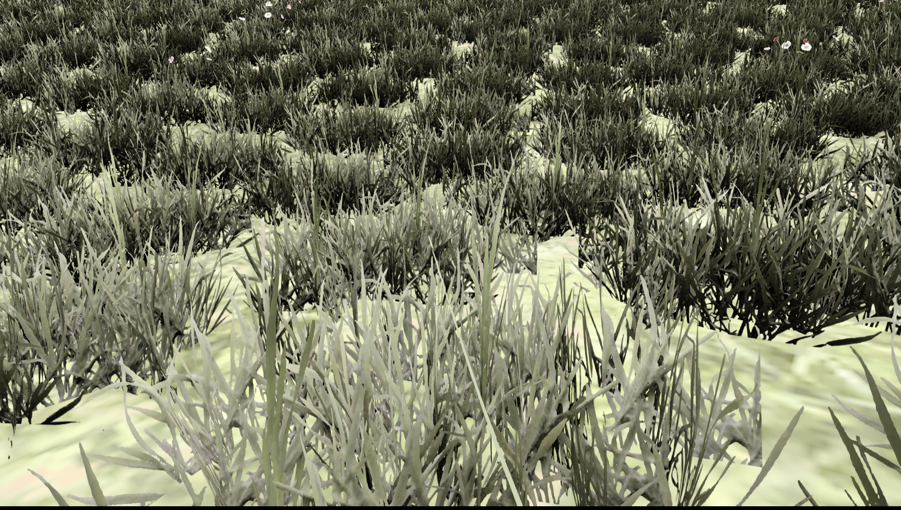
© 2021 Activision Publishing, Inc.
Notes:
This is our nightmare scenario. Tessellated terrain covered in alpha tested grass.
TnD generates its own problems w.r.t. quad occupancy, due to tiny triangles.
Foliage on the other hand, generates tons of quads due to depth complexity and alpha cutouts, even if base level of triangles is manageable.

Slide 43
Quad Occupancy | F+ Foliage | V+ Foliage | F+ Terrain | V+ Terrain | F+ Terrain TnD | V+ Terrain TnD
VRS layout (4xMSAA) | 48% | 87% | 53% | 89% | 18% | 89%
Default layout | 64% | 87% | 78% | 89% | 29% | 89%
Time(ms) | F+ Foliage | V+ Foliage | F+ Terrain | V+ Terrain | F+ Terrain TnD | V+ Terrain TnD
VRS layout (4xMSAA) | 3.8 | 2.4 | 1.2 | 0.85 | 3.3 | 0.87
Default layout | 3.1 | 2.4 | 1.1 | 0.85 | 2.7 | 0.87
WARNING : V-Buffer results are from our test framework and do not reflect final performance
© 2021 Activision Publishing, Inc.
Notes:
Following numbers should be taken with a grain of salt. They are not from our runtime (rather our replay framework). Shaders have similar functionality but V+ is not optimized yet, and still lacks support for certain features.
That said, we can objectively observe much improved quad occupancy, where loss below 100% occurs only due to draw call silhouette edges (from foliage on terrain overlap).
This could be mitigated in fully bindless pipeline, at the additional cost of in shader complexity and more expensive constant loading (in our experience this is not yet a win w.r.t. optimizations we have in progress).

Slide 44
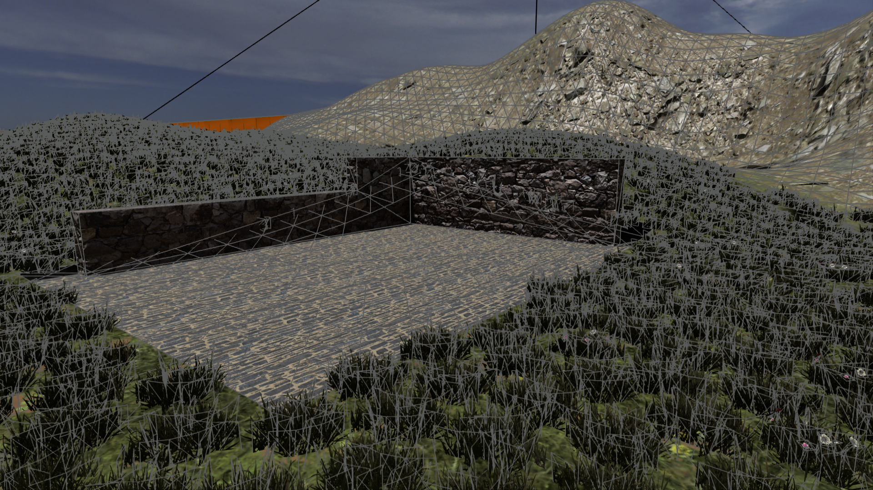
Future Development : Hybrid F+/V+ Rendering
© 2021 Activision Publishing, Inc.
Notes:
In the future we would like to support hybrid F+ / V+ rendering on tile basis.

Slide 45
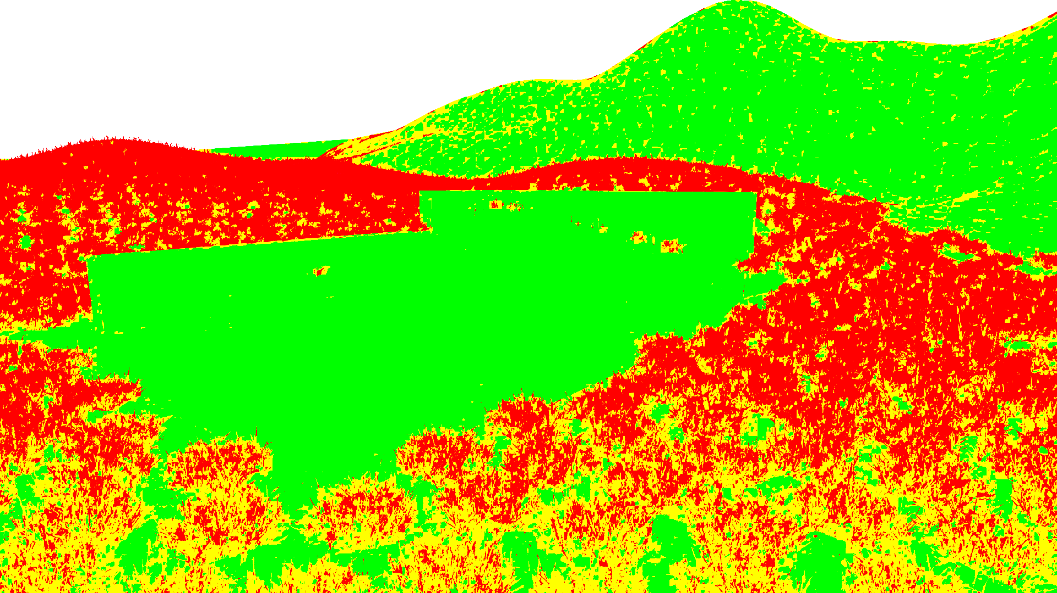
Future Development : Hybrid F+/V+ Rendering
© 2021 Activision Publishing, Inc.
Notes:
V+ pre-pass stage can estimate quad occupancy per tile and then use heuristics to pick the best optimal rendering mode for each tile.

Slide 46
V+
F+
© 2021 Activision Publishing, Inc.
Notes:
Then draws would be submitted on-demand per tile basis.
Some tiles would use F+ and some would use V+.
We expect lower resolutions gracefully fallback to V+, while higher resolutions use more F+ tiles.

Slide 47

Q&A
research.activision.com
michal@infinityward.com
@MichalDrobot
© 2020 Activision Publishing, Inc.
Notes:
This ends the talk. Thank you!

Slide 48
References
[AALT15] Gpu-Driven Rendering Pipeline, Sebastian Aaltonen, Ulrich Haar, Siggraph 2015
[BURNS13] The Visibility Buffer: A Cache-Friendly Approach to Deferred Shading, Christopher A. Burns, Warren A. Hunt, Journal of Computer Graphics Techniques 2013
[DACH15] Deferred Attribute Interpolation for Memory-Efficient Deferred Shading, Carsten Dachsbacher, Christoph Schied, High Performance Graphics Conference 2015
[DOGH16] Deferred+, Hawar Doghramachi, Jean-Normand Bucci, GPU Zen 1, 2016
[DRO20] Software-Based Variable Rate Shading, Michal Drobot, Siggraph 2020
[ENGEL16] Triangle Visibility Buffer, Wolfgang Engel, 2016
[RAY20] Scaling Content, Rulon Raymond, GDC 2020
[WIL16] Optimizing the Graphics Pipeline with Compute, Graham Wihlidal, GDC 2016

Slide 49
UGB Shader Facing API
// baseOffset - surface knows its offset to respective data stream from UGB
// vtxOffset – coming from SV_VertexID or similar
float2 UGB_GetPackedUV( uint baseOffset, uint vtxOffset )
{
  uint byteOffset = vtxOffset * UGB_UV_SIZE;
  uint physByteOffset = UGB_GetPhysByteOffset( baseOffset, byteOffset
  // custom format unpacking
  return UnpackHalf2FromUInt( UGB_PHYS_BUFFER.Load( physByteOffset ) );
}

Slide 50
UGB VIRTUALIZATION SHADER IMPLEMENTATION
uint UOB_GetPhysByteOffset( uint vpageStart, uint byteOffset )
{
#if UGB_RAW_MEM_READS // console (unified memory) path
return vpageStart + byteOffset;
#else // #if UGB_RAW_MEM_READS // pc path
uint virtPageID;
uint physPageID;
virtPageID = vpageStart + ( byteOffset >> UGB_PAGE_BYTE_SHIFT );
physPageID = UGB_VIRTUAL_PAGE_TABLE.Load( virtPageID * UGB_VIRT_PAGE_TABLE_ENTRY_SIZE );
return ( physPageID * UGB_PAGE_BYTE_SIZE + ( byteOffset & UGB_PAGE_BYTE_MASK ) );
#endif // #else // #if UGB_RAW_MEM_READS
}

Slide 51
struct SModelCollExpansionArg
{
uint smodelCollectionIndex; // collection index from precomputed collection
uint validLodBits; // lod residency
uint lodOffset; // min lod for collection of models
uint lodCount; // range of possible lods
uint lodCullScalePacked; // range of possible lods
uint viewType; // which view to render to (main camera, shadows etc.)
};
struct SModelCollectionInfo
{
uint firstStaticModel; // offset into instance buffer of model data
uint staticModelCount; // total collection model count
uint smodelIndex; // index of sModel used by collection
uint flags;
};
struct SModelInfo
{
uint firstSModelSurfIndex; // offset to collection of meshes in sModel
uint numSurfs; // meshes in sModel
uint numLods;
Bounds bounds;
};

Slide 52
void vis_buffer_prepass_merge_write_tris( uint triID, uint localThreadID )
{
batchMasks[localThreadID] = (uint64)0; // groupshared uint64 batchMasks[64]
uint wgIndex = triID >> 8; // clusterID
uint surfTriID= triID & 0x3F; // triangleID
uint64 wgBits = 1 << surfTriID; // visBit for visMask per thread
uint64 exec = GetExecMask(); // get all active thread mask in case some were killed previously (VRS / early out)
uint wgCount_s = 0;
uint wgLDSIndex_v = 0;
uint64 wgMask_v = (uint64)0;
[loop]
while( CountSetBits64SGPR( exec ) ) // iterate until any thread is active
{
uint first_bit = GetFirstSetBit64SGPR( exec ); // grab first lit bit of exec mask
uint firstValue = ReadLane( wgIndex, first_bit ); // grab matching first value from vector reg
uint64 mask_s = BallotMask( firstValue == wgIndex ); // scalar mask of matching threads
if( Predicate( mask_s ) ) // close mask to populate out of loop vectors
{
wgMask_v = mask_s; // populate masked vectors of clusterID match mask
wgLDSIndex_v = wgCount_s; // populate masked LDS offsets to batchmasks
}
wgCount_s++; // move to next cluster workgroup
exec &= ~mask_s; // kill main mask threads
}
InterlockedOr( batchMasks[wgLDSIndex], wgBits ); // merge triangle visBits for respective clusters in-wave
if( MaskBitCnt( wgMask ) == 0 ) // invoke only for first occurrence of each cluster in threads (once per batch)
{
// Merge triangle visBits for respective clusters in-memory
InterlockedOr( outCulledTriClusterBuffer[wgIndex].triVisMask, batchMasks[wgLDSIndex] );
}
}
Notes:
Fully optimized version is a bit more complex and uses wave intrinsic in case of bigger triangles per-wave.
In case of VRS setup with MSAA planes, read all planes, and compact all active pixels into an LDS queue.
Then run vis_buffer_prepass_merge_write_tris over LDS queue as many times as there are 64 thread worth batches.

Slide 53
UGB VIRTUALIZATION IMPLEMENTATION
void GP_InitGlobDrawData( uint vertexId)
{
#if USE_GPU_PIPELINE_NON_INDEXED
uint triIdx = ( GetSVertexOffsetId() + vertexId ); // global vertexID = drawOffset + drawVertexID
// triangle is shared for each 3 verticies
g_triID = gpuPipelineIndexBuffer.Load( ( triIdx / 3 ) * 4 );
uint wgGroupIndex = ( g_triID >> 8 );
// workgroup is global per frame referencing a cluster
GPWorkgroupArgsworkgroupArg = GP_UnpackWorkgroupArgsFromUint(
gpuPipelineClusterWorkGroupArgsBuffer.Load( wgGroupIndex * GP_WORKGROUP_ARGS_ELEM_SIZE ) );
// surfIndex references mesh that workgroup was processing
uint surfIndex = workgroupArg.elemID;
uint surfWorkGroupID = GP_UnpackClusterIndexFromID( workgroupArg.workgroupID );
uint inputTriangleOffset = surfWorkGroupID * GP_CLUSTER_SIZE + ( g_triID & 0xFF );
// load offsets to mesh data
GPPerSurfTri surfTri = GP_GetPerSurfTri( GET_PERSISTENT_BUFFER( perSurfData ), surfIndex );
// load indices
g_vertexID = UIB_GetTriIndex( surfTri.uibBaseOffset, inputTriangleOffset + surfTri.triOffset, triIdx % 3);
g_surfID = workgroupArg.elemID;
#else // #if USE_GPU_PIPELINE_NON_INDEXED
#define GP_GETSURFID( VERTEX_ID ) ( ( VERTEX_ID ) >> 16 )
#define GP_GETINDEX( VERTEX_ID ) ( ( VERTEX_ID ) & 0xFFFF )
g_surfID = GP_GETSURFID( vertexId );
g_vertexID= GP_GETINDEX( vertexId );
#endif // #if USE_GPU_PIPELINE_NON_INDEXED
}

